Slide 1
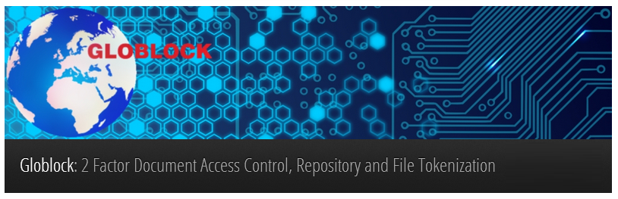
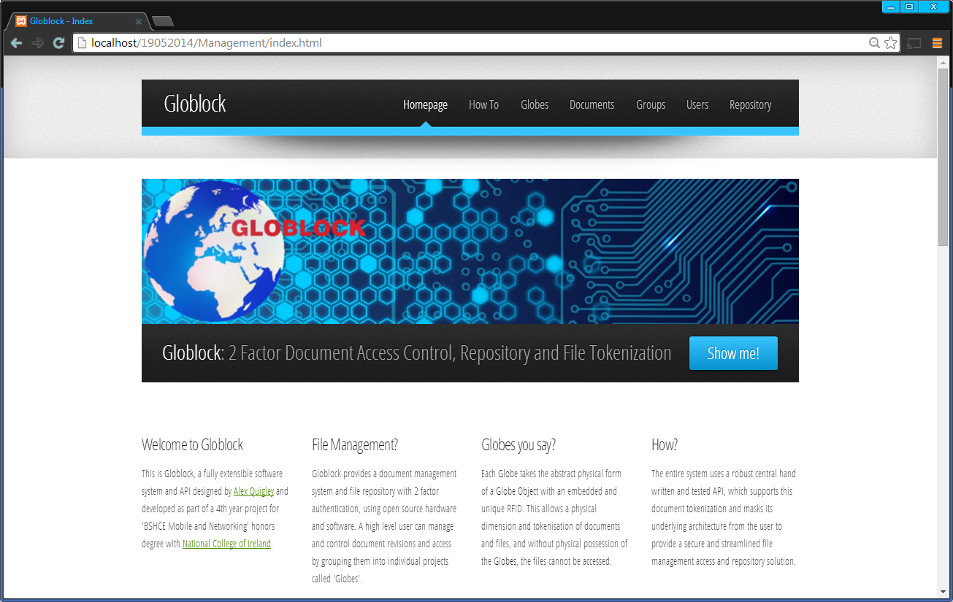
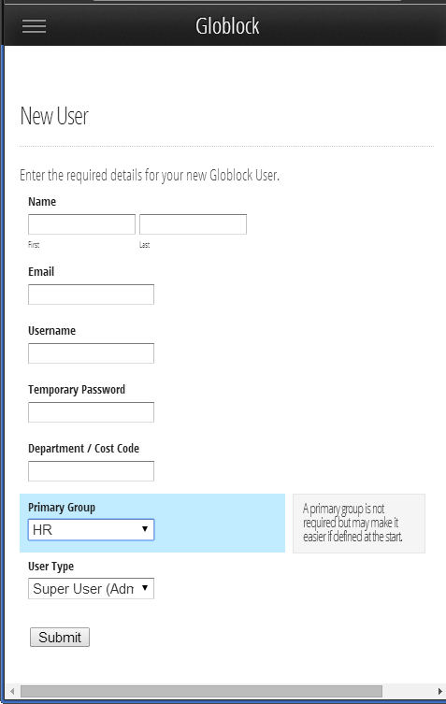
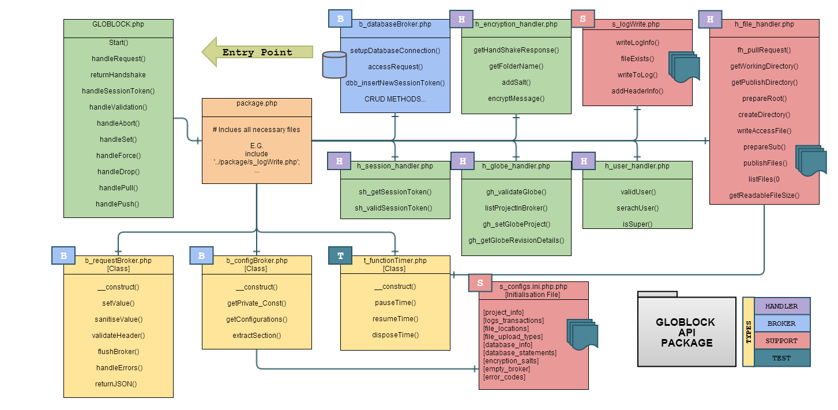
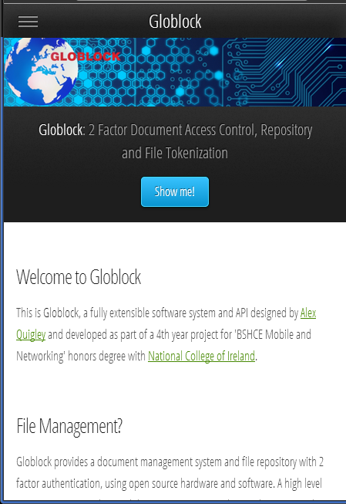
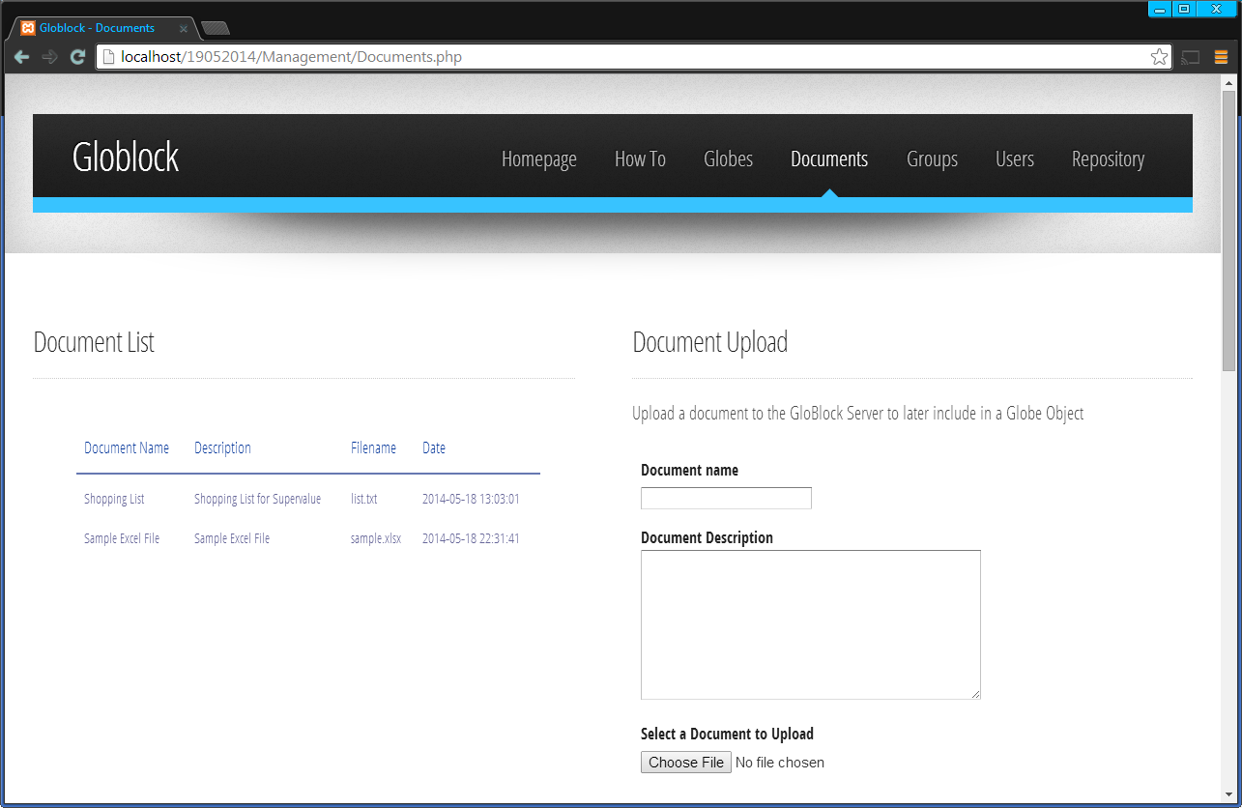
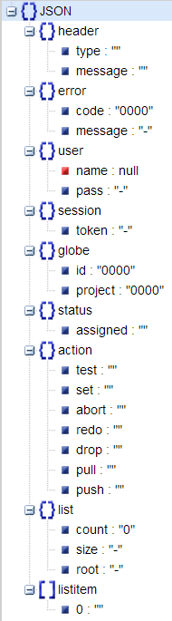
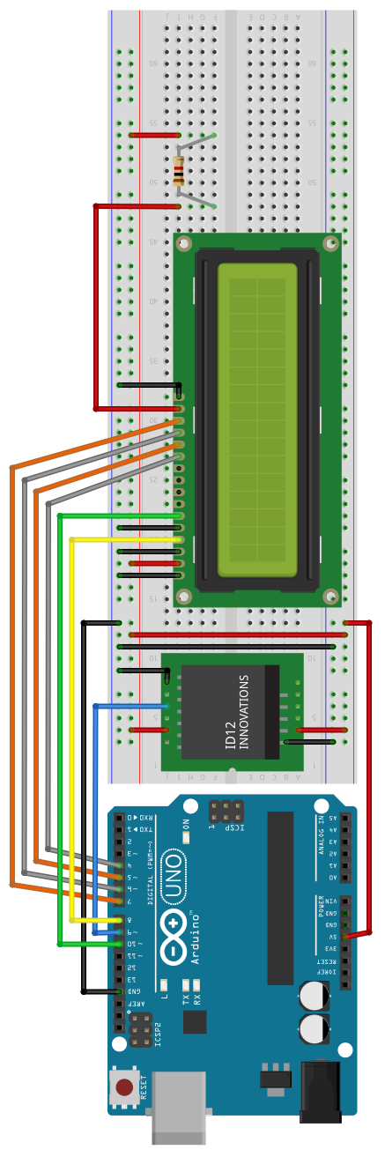

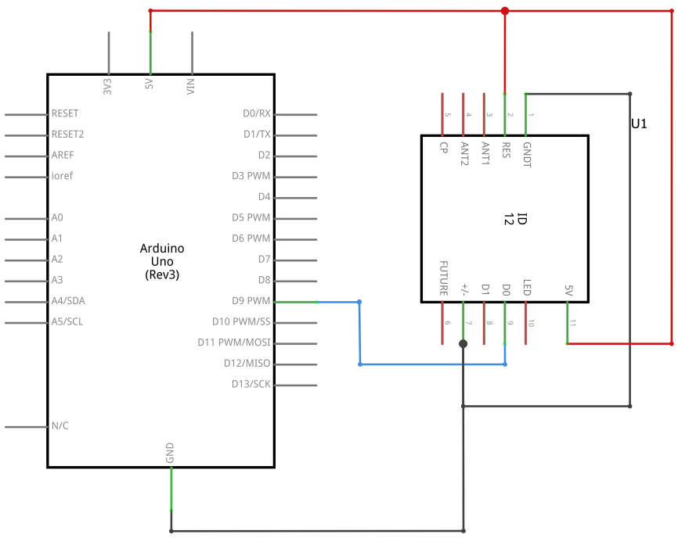
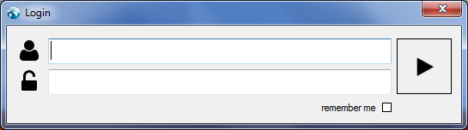













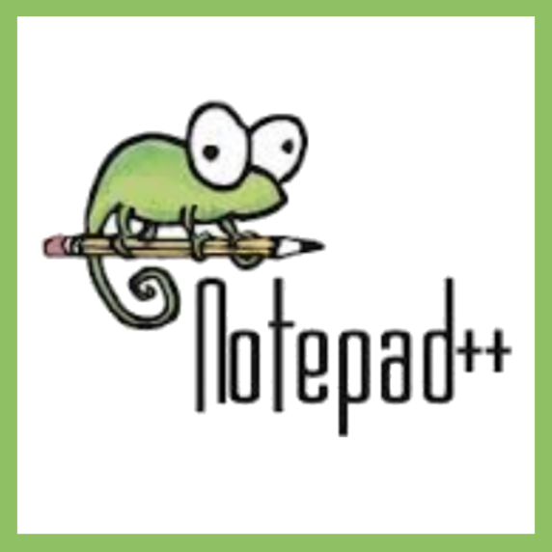


Alex Quigley
X10205691
BSHCE4
Networking and Mobile
Globlock provides a document management system and file repository with 2 factor authentication, using open source hardware and software.
A high level user can manage and control document revisions and access by grouping them into individual projects called 'Globes'.
Each 'Globe' takes the abstract physical form of a 'Globe Object' with an embedded and unique RFID.
The entire system uses a robust central API, supports this document tokenization and masks its underlying architecture from the user to provide a secure and streamlined file management access and repository solution.
HAND
SHAKE
SESSION
VALIDATE
ABORT
SET
DROP
FORCE
PULL
PUSH
Management
Web Application
Core
API
Hardware Interface
Technology
Used:

